Slide 1
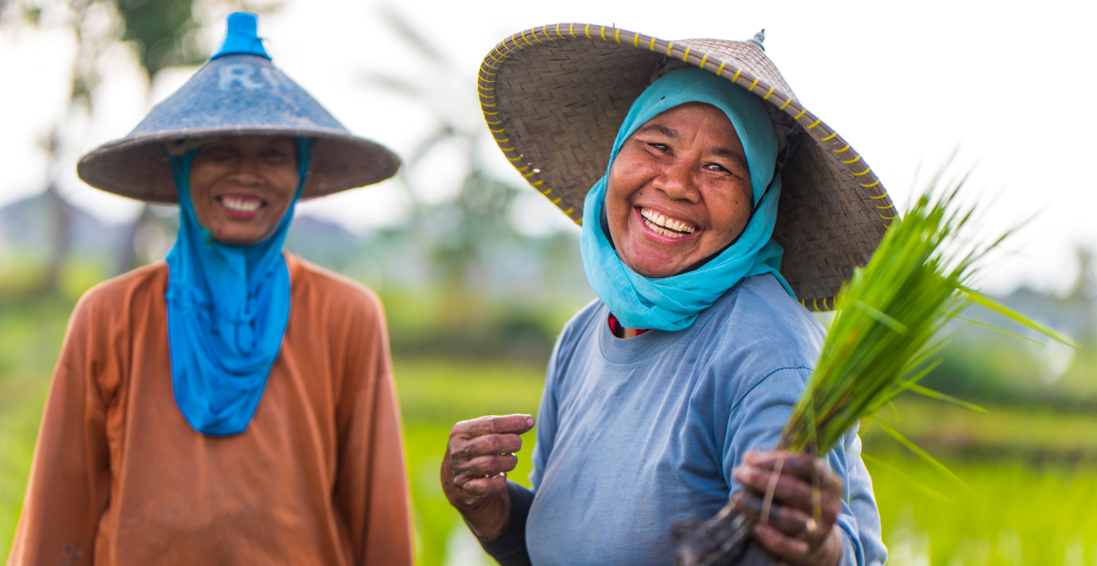

THE CONSCIOUS FOOD SYSTEMS ALLIANCE
Inner Capacities for Regenerative Food Systems

Slide 2

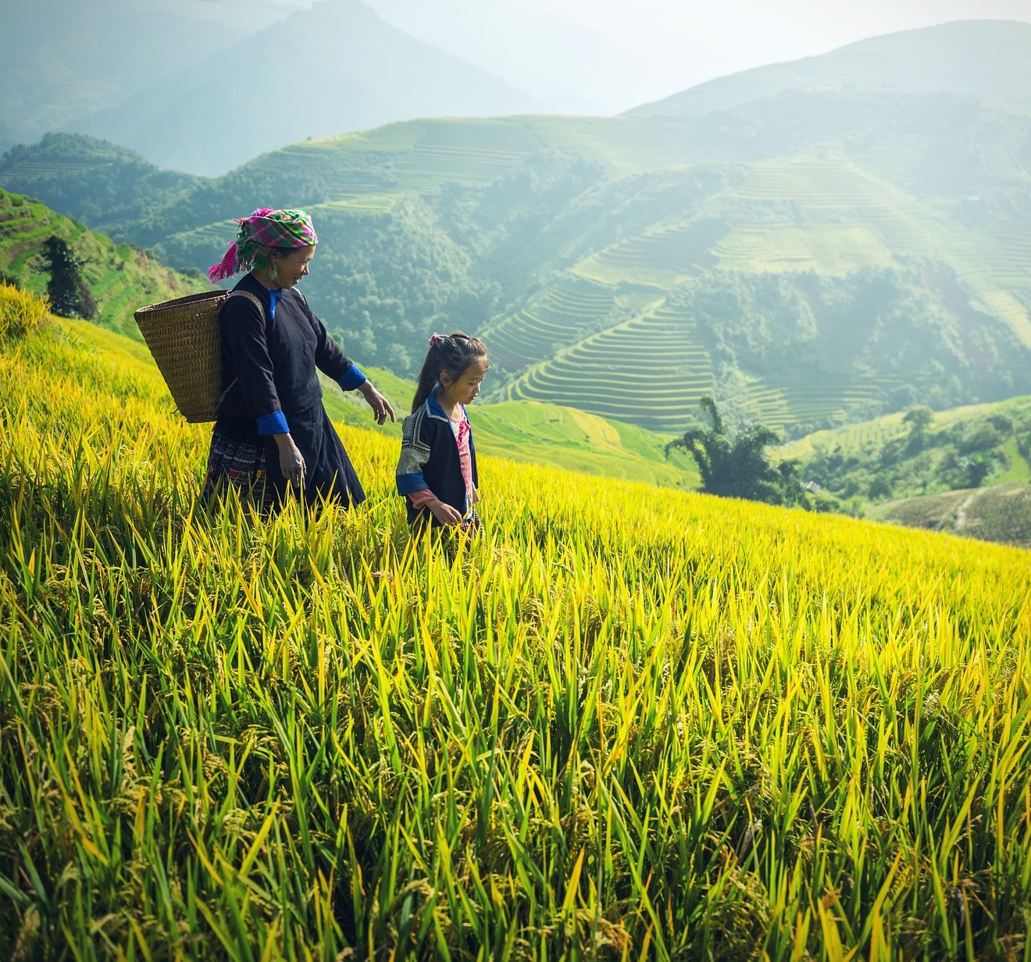

The Conscious Food Systems Alliance (CoFSA)
CoFSA is a movement of food, agriculture, and consciousness practitioners, convened by UNDP, and united around a common goal: to support people from across food and agriculture systems to cultivate the inner capacities that activate systemic change and regeneration.
CoFSA's vision is to establish the cultivation of inner capacities as a key evidence-based approach to envision and create regenerative food systems; and to build legitimacy for this agenda

Slide 3
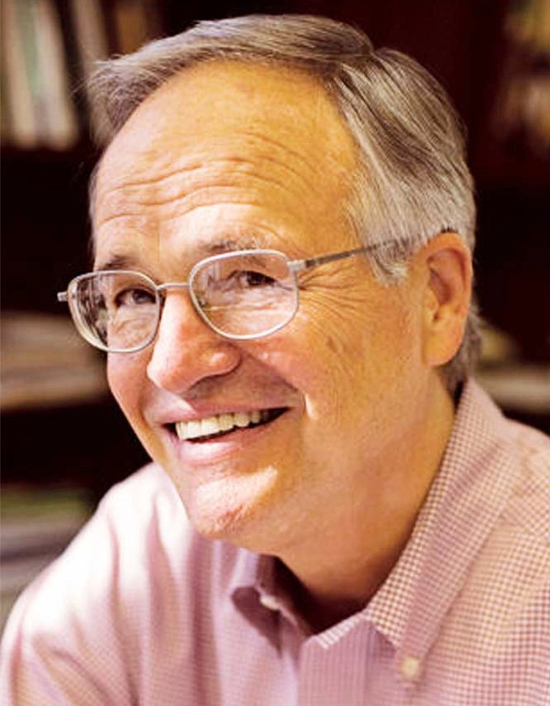
Addressing a Major Blindspot in our Work
"I used to think that the top environmental problems were biodiversity loss, ecosystem collapse and climate change. I thought with 30 years of good science we could address those problems. But I was wrong.
The top environmental problems are selfishness, greed and apathy... And to deal with these we need a spiritual and cultural transformation—and we scientists don’t know how to do that."
Gustave Speth
UNDP Administrator (1993-1999)

Slide 4
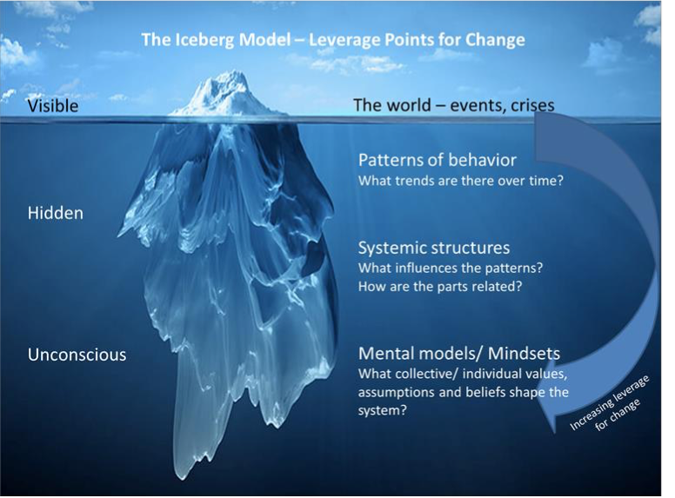




An Approach Grounded in Science
A cultural narrative of separation—from self, others, and nature—underpinning the polycrisis.
Inner transformation as a powerful lever for systemic change to be integrated as a complementary approach.
Knowledge alone is not enough to activate behavior change. Need to engage with emotions, values and identities.
Evidence that consciousness practices can support this inner change.
The Iceberg Model. Source: Adapted from Meadows (1999), presented in Wamsler (2021)

Slide 5

Inner Human Barriers
to Food Systems Change
The barriers to change lie not only in systemic structures but within the human mind and heart:
Extractive mindsets and cultural narrative of separation from one-self, each another and the natural world
Reductionism and siloed thinking inhibiting our capacity to approach complex challenges in a systemic manner
A Lack of Collaborative Capacities
Care Deficit

Slide 6
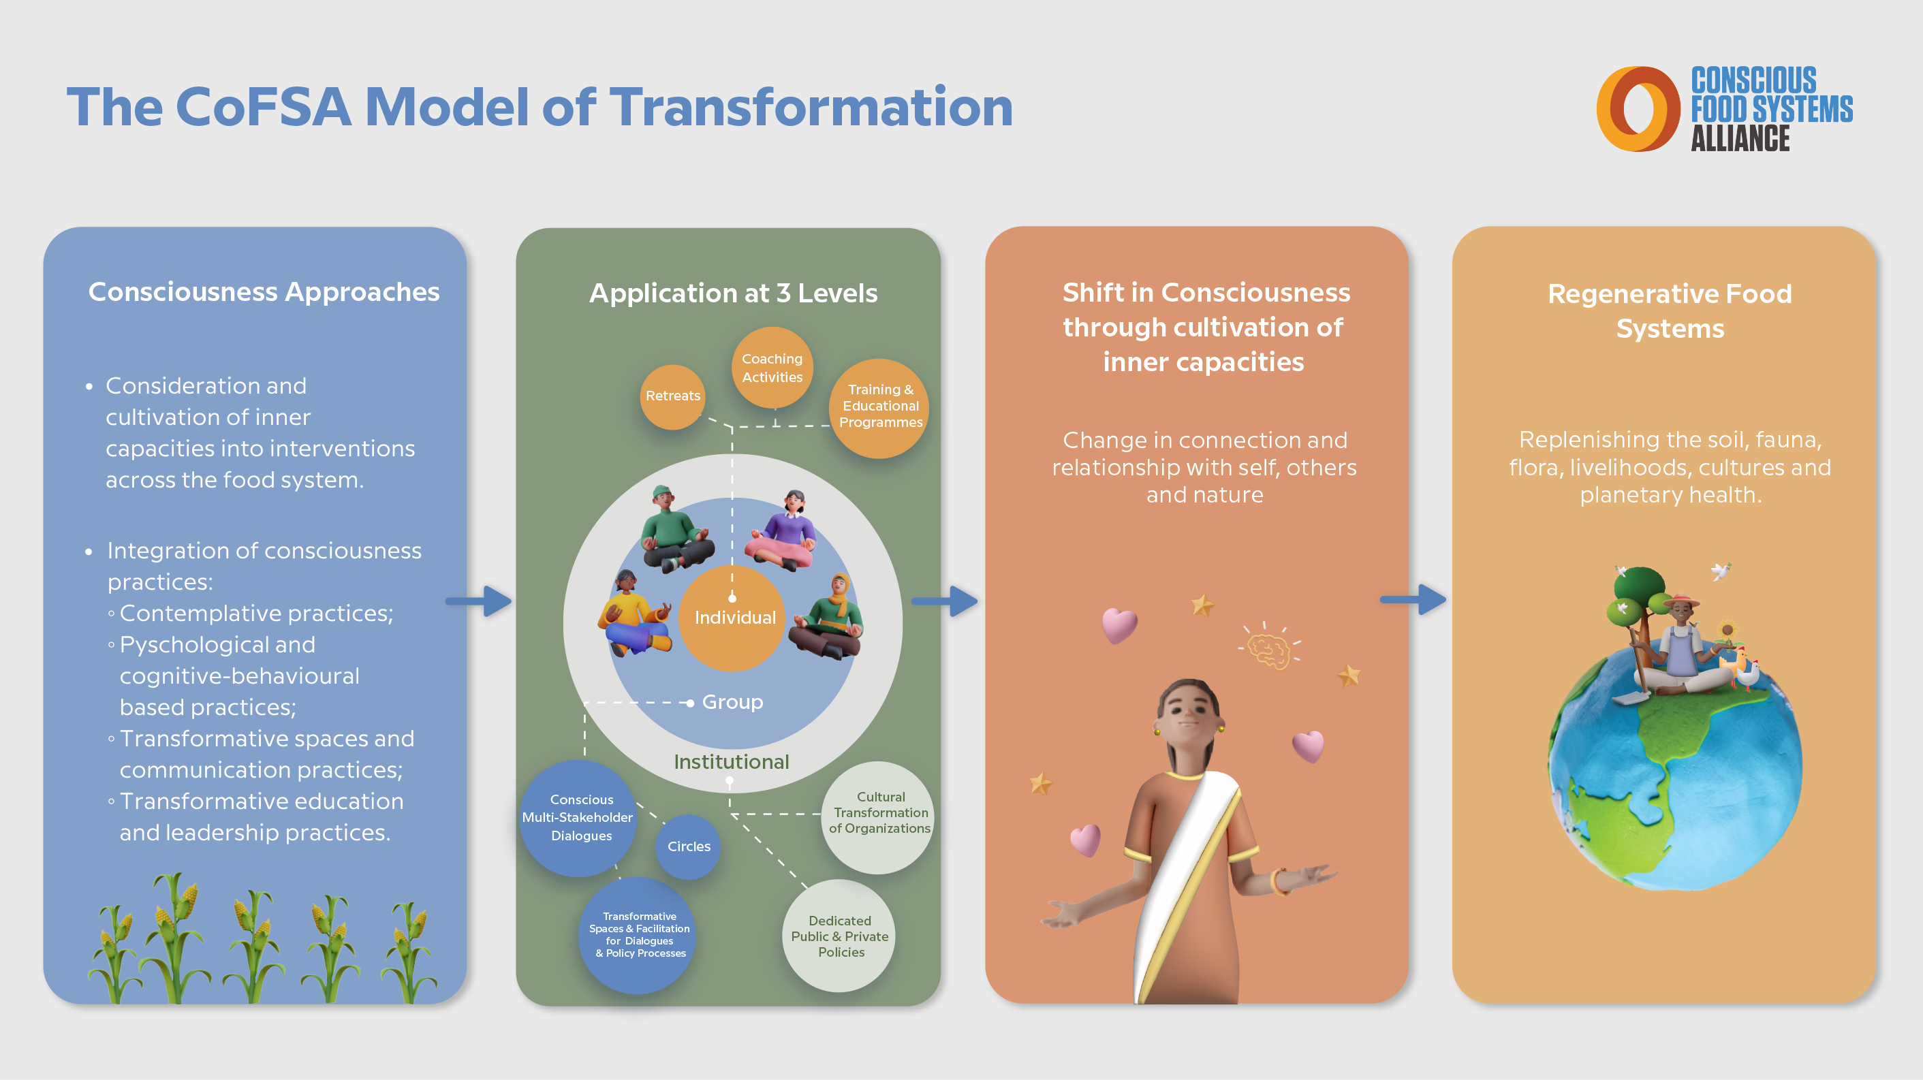
Notes:
The CoFSA portfolio of interventions focuses on working with governments, companies, farmers and development practitioners to support food systems transformation across three main areas:
Food Systems Policy and Pathways (including Food Policy Reform, and Multistakeholder Dialogues);
Sustainable Landscapes (including Conscious Farming and Local Community Development, and revitalizing and strengthening Traditional Wisdom); and
Supply Chains Transformation (including Cultural Transformation of Organizations and Conscious Consumption).

Slide 7
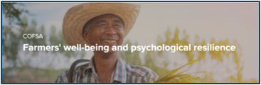
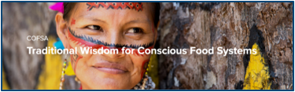
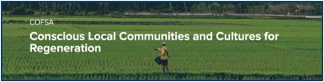
Areas of Work
Bring together experts and stakeholders to share learnings, generate new insights and support collaboration and implementation on COFSA main areas of intervention.
Identify existing initiatives, expertise, methodologies and tools, as well as opportunities for adaptation, replication and scale-up.
Establish an Action group open to CoFSA members to enable continued learning and collaboration among participants.

Slide 8
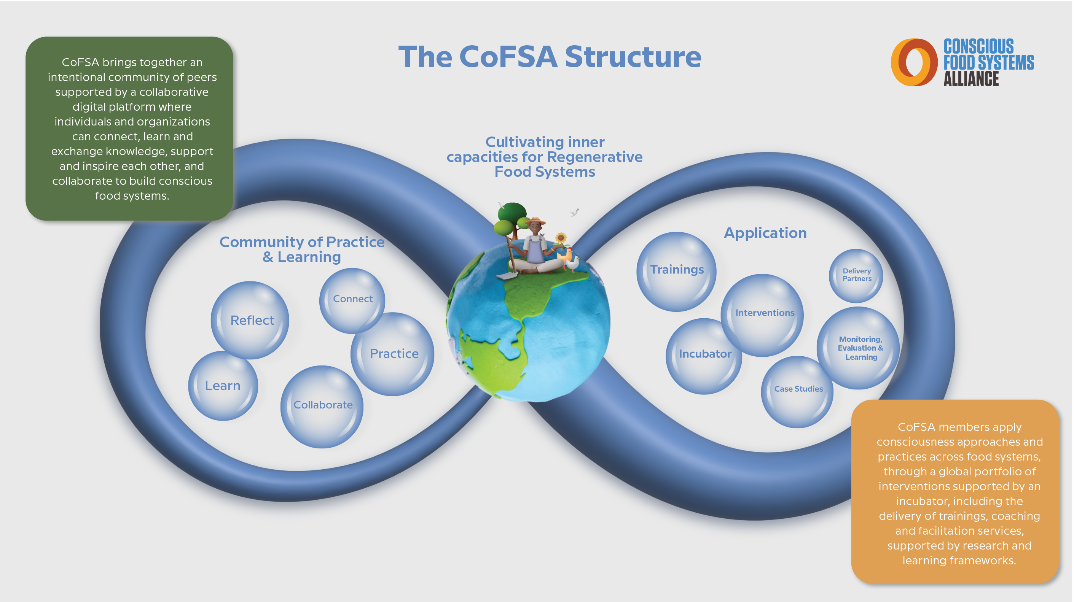
Notes:
The CoFSA portfolio of interventions focuses on working with governments, companies, farmers and development practitioners to support food systems transformation across three main areas:
Food Systems Policy and Pathways (including Food Policy Reform, and Multistakeholder Dialogues);
Sustainable Landscapes (including Conscious Farming and Local Community Development, and revitalizing and strengthening Traditional Wisdom); and
Supply Chains Transformation (including Cultural Transformation of Organizations and Conscious Consumption).

Slide 9




THANK YOU
www.consciousfoodsystems.org
cofsa@undp.org
Conscious Food Systems Alliance
@undp_cofsa

