Slide 1





Educating the Lawyers of the Future
(Mexico)
@NuestroFuturoAC

Slide 2

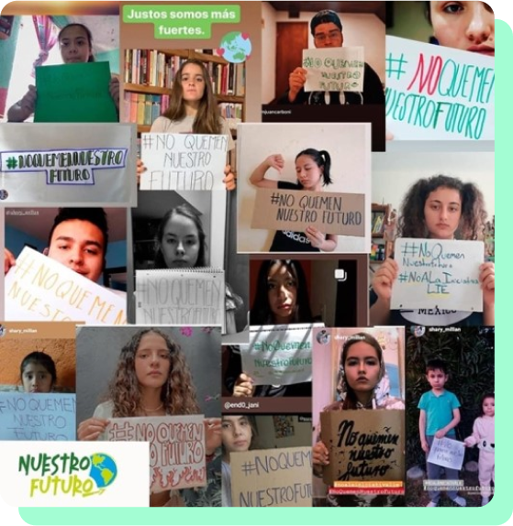
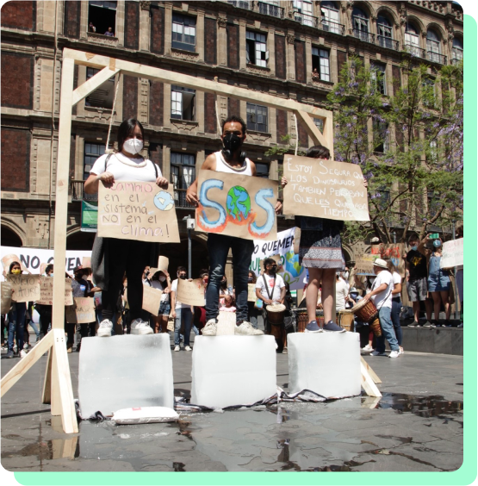

Nuestro Futuro “Our Future”
Our NGO began as a collective of young people concerned about the effects of climate change.
The organization is part of the global and national youth movement that fights for a healthy and safe environment and that the Earth's temperature does not continue to rise.
Today, the organization focuses on promoting climate justice, compliance with mitigation laws, as well as supporting the adaptation of vulnerable communities.
Notes:
Aquí después en el útloimo

Slide 3



The problem?
Even though the regulatory framework for climate change mitigation and adaptation policy in Mexico was approved a decade ago, it is not being implemented by Mexican authorities.
On the contrary, the government is taking more and more regressive measures every day.
Furthermore, young future lawyers want to help but do not know how to, aggravating climate anxiety.
Faced with this challenge, we believed that educating young people, future lawyers, about climate change, its consequences, and solutions is crucial for our generation to drive actions aimed at climate justice.

Slide 4
The solution:
The objective is to teach young law students in Mexico how to fight climate change through public policy, law, and compliance, which is essential for Mexican climate change policies to advance and become increasingly ambitious.
Our two main lines of action:
Content creation and design.
Generate the didactic and pedagogical material necessary to teach a seminar on climate change and human rights for law students.
1)
Collaboration with law universities in Mexico. Implementation of the seminar on climate change and human rights for young generations aimed at law students.
Implementation.
2)

Slide 5
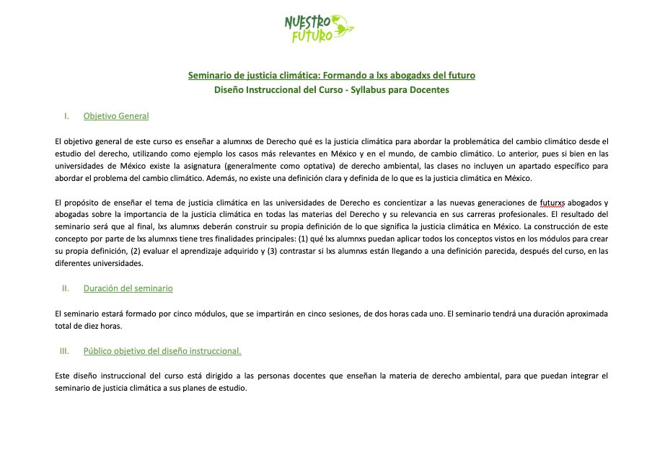
What have we achieved so far?
We successfully designed the first manual in Mexico for teaching law at universities with a climate change and nature perspective.

Slide 6
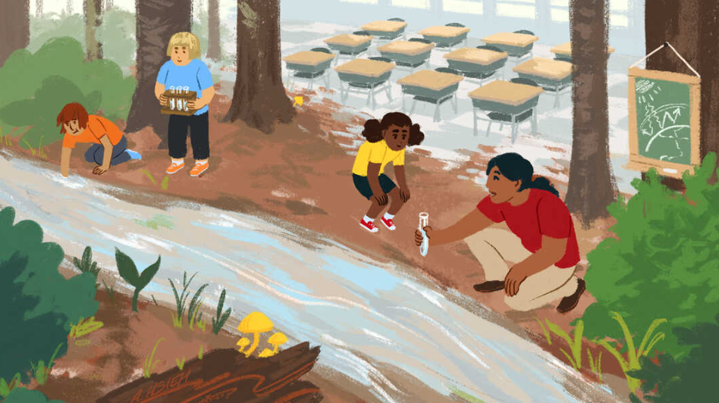
What is next?
Now that we have the first climate justice seminar for law students in Mexico ready, we will approach universities and law professors to create alliances and implement the next phase of the project in three law universities.

Slide 7


Long-Term Project Impact
The potential long-term impact we will achieve is to form a generation of young people who are educated in climate change, with a nature perspective, specifically regarding the regulatory framework in Mexico, in order to ensure that the next generation will know how to defend their environmental rights.

Slide 8
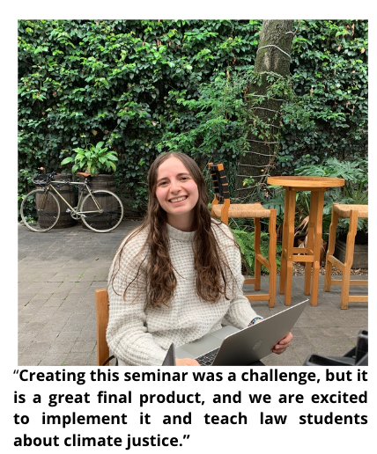
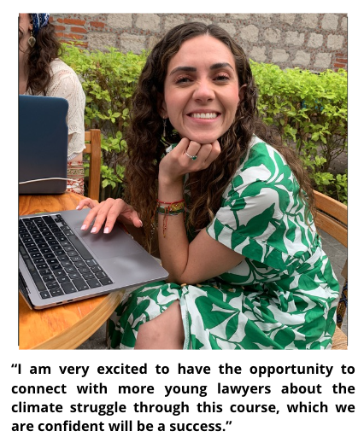
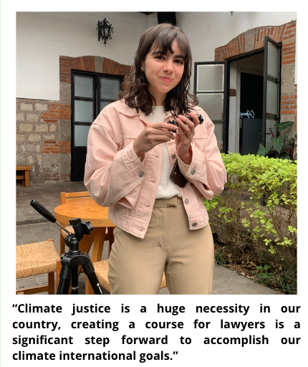
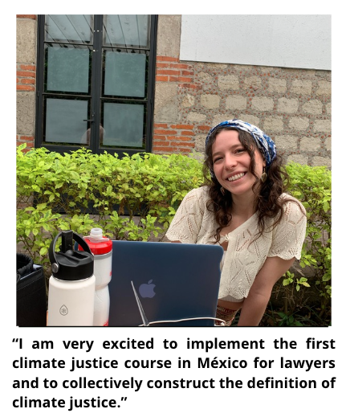
Long-Term Project Impact

Slide 9
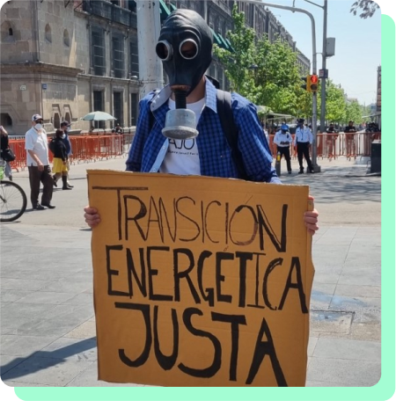
Advancing Legal Knowledge and Public Impact in Mexico: An Example
On March 24, 2021, Nuestro Futuro, A.C. and four other youth organizations with the support of the #YouthForOurFuture collective, filed an amparo lawsuit against the Mexican Government challenging the 2021 amendments of the Electric Industry Law.
The legal strategy was accompanied by a communication campaign on social media, and a podcast called #Don'tBurnOurFuture (#NoQuemNuestroFuturo).

Slide 10
Advancing Legal Knowledge and Public Impact in Mexico: An Example
The Main Argument: The Mexican State is constitutionally obligated to mitigate and adapt to climate change, which necessarily implies designing and implementing an energy policy that favors the energy transition.
The Decision: The Court decided that the amendments to the Electric Industry Law violated the right to a healthy environment and the Paris Agreement by favoring the generation of electricity through fossil fuels.
The Mexican Government has a duty to increase the proportion of clean energy in the electricity sector as part of its obligation to mitigate climate change.

Slide 11




Thank you!
Speaker: Maria Maldonado
@NuestroFuturoAC

