Slide 1



Youth4Climate - Call for Solutions
2025
Deep Dive Webinar on
Climate, Peace and Security

Slide 2
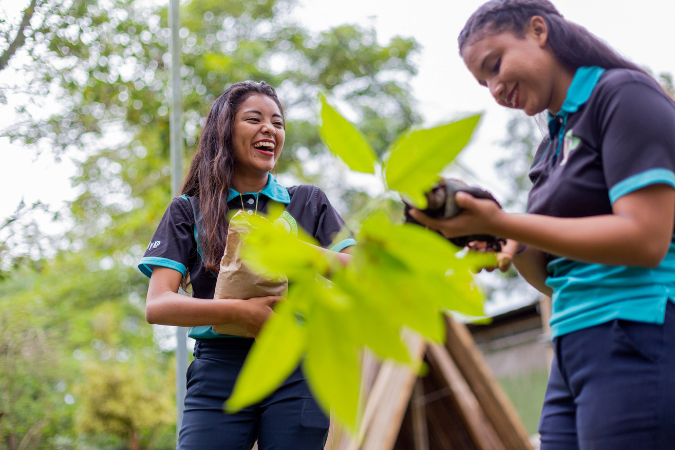
Climate, Peace and Security
Thematic Priority
• What is Climate, Peace
and Security?
• Why are youth important
to this agenda?

Slide 3
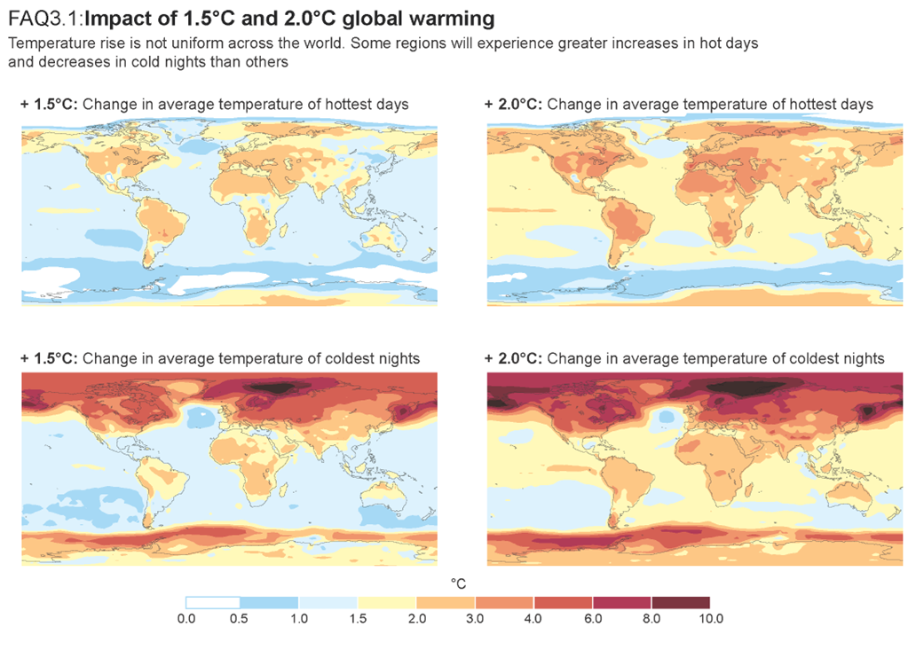
What is Climate, Peace and Security?
3.3-3.6 billion people
live in countries most affected by climate change
IPCC 6th Assessment report

Slide 4
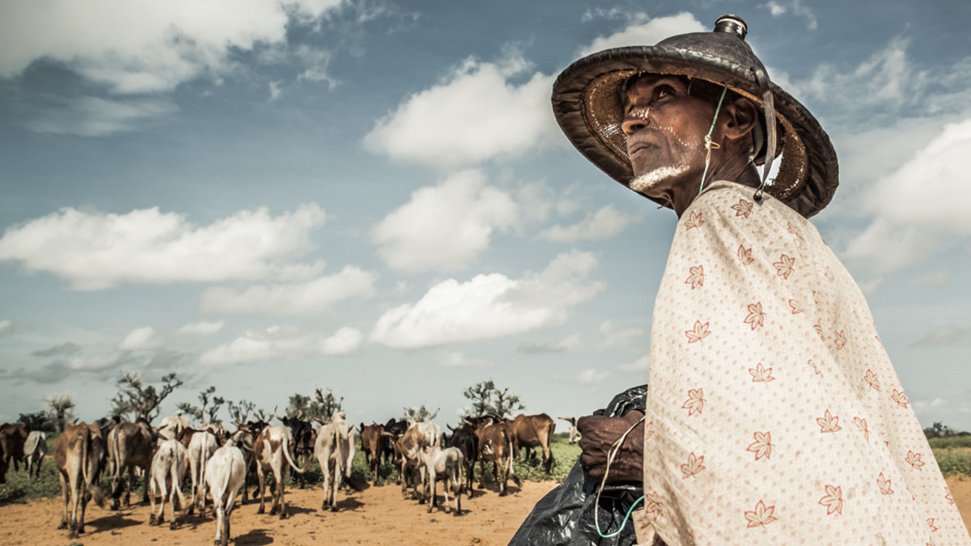
What is Climate, Peace and Security?
12 of the 20 countries
most vulnerable to climate change, also suffer from conflict
ICRC, 2020

Slide 5
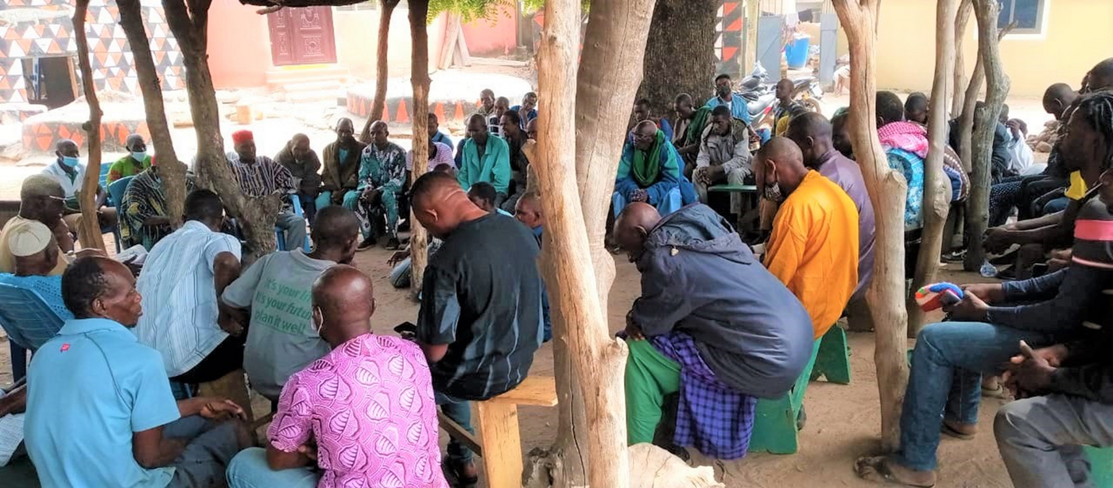
Why are youth important to the CPS agenda?
700+ million
young people ( 15-34 years of ages )
live in conflict and fragility-
affected contexts?

Slide 6
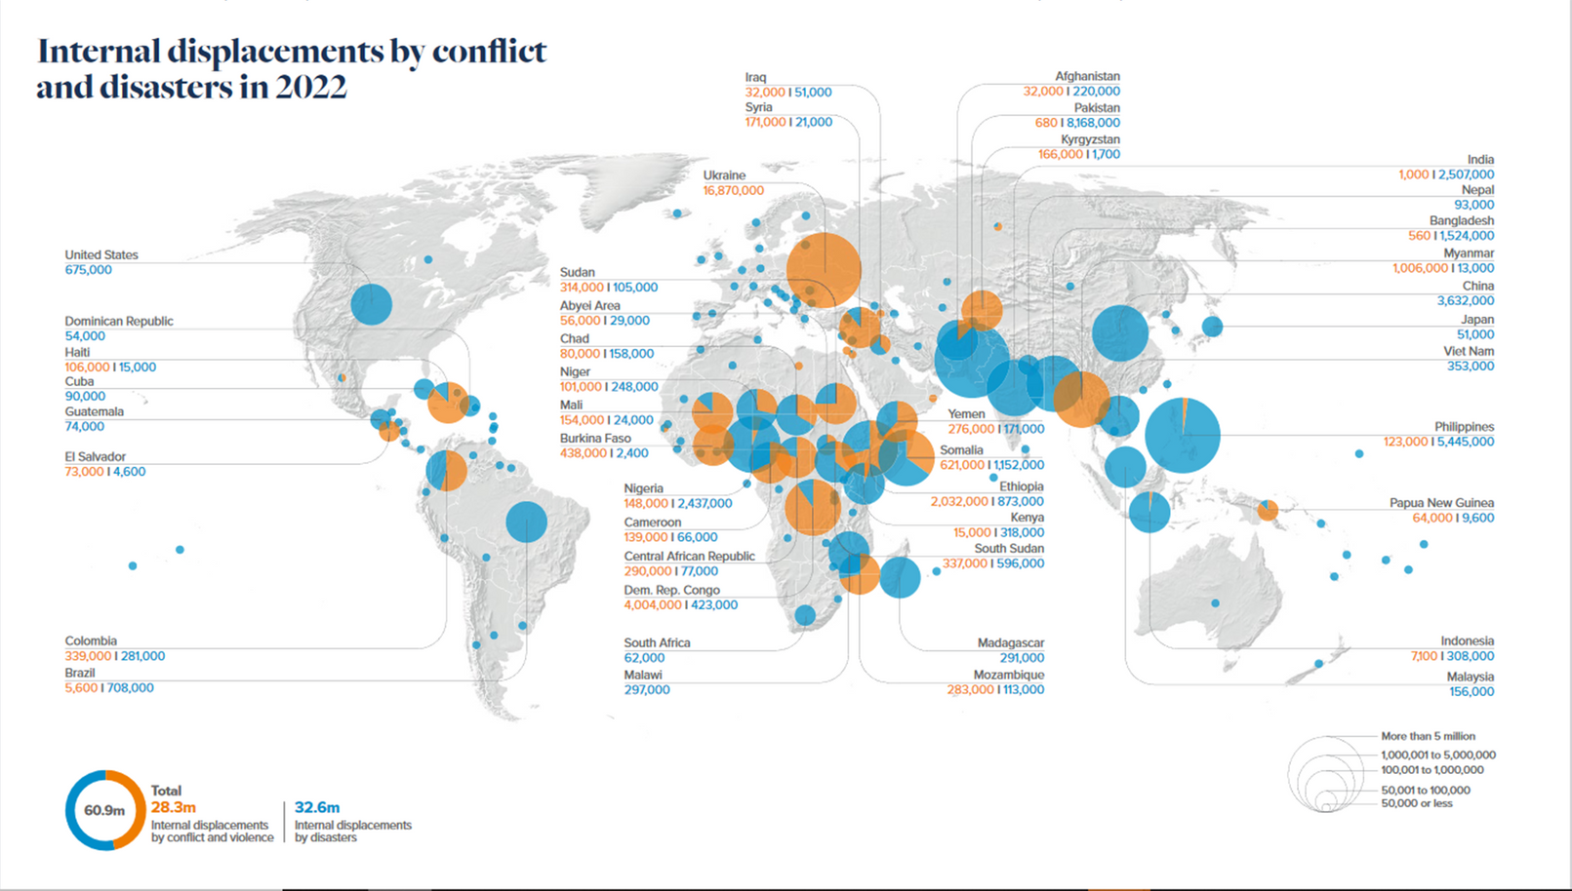

Slide 7
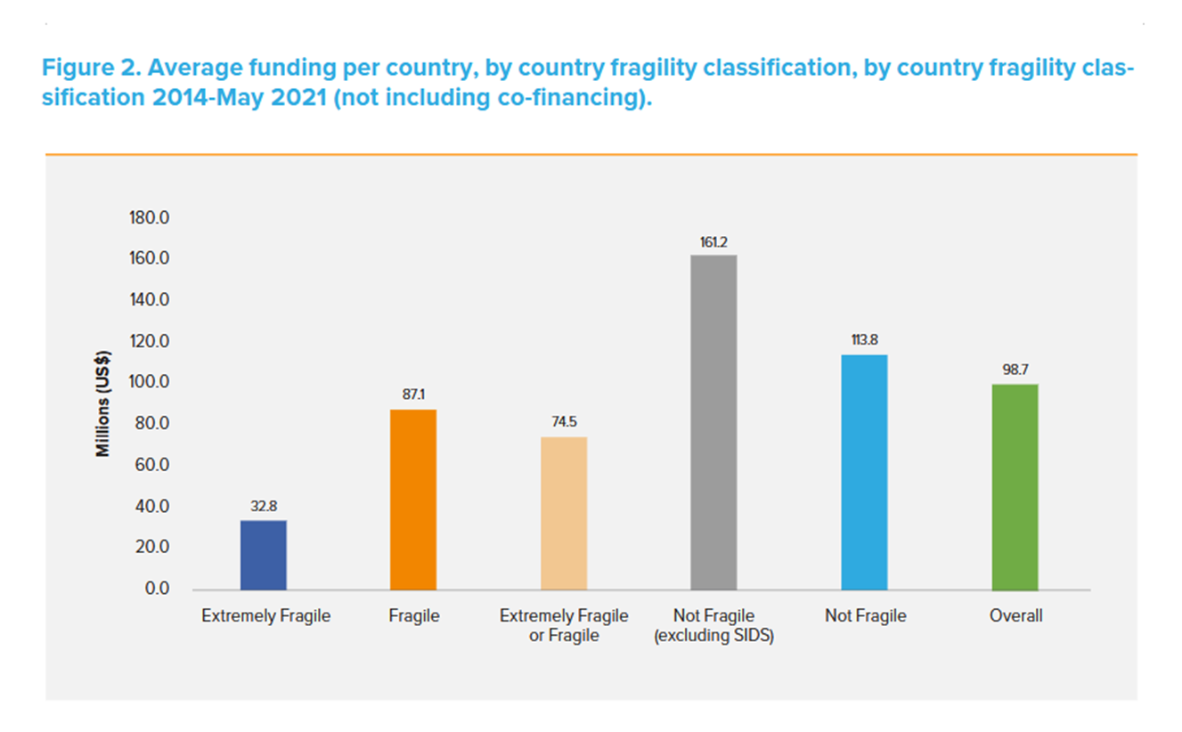
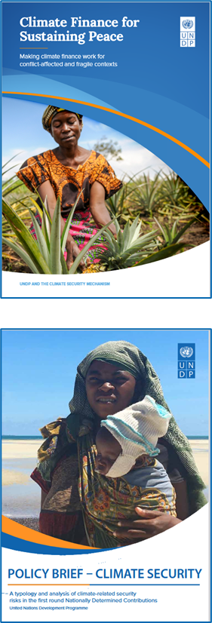

Slide 8
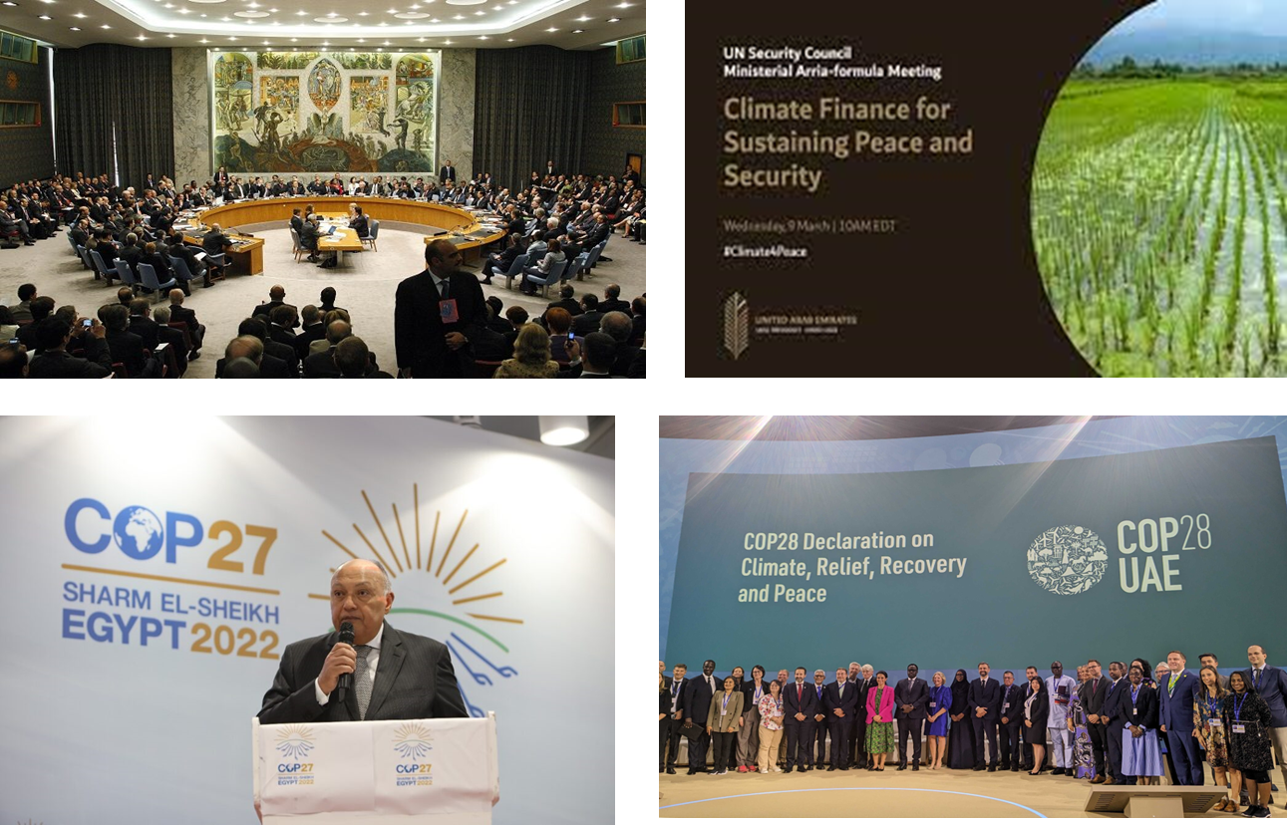

Slide 9
What is Youth-led Climate, Peace and Security?
Youth-driven solutions which:
• Climate-proof conflict prevention, post-conflict stabilization and peacebuilding
• Ensure that mitigation and adaptation are peace positive
• Integrated approaches to climate action, policy, finance and sustaining peace
• Strengthened cross-border, regional and sub-regional approaches

Slide 10
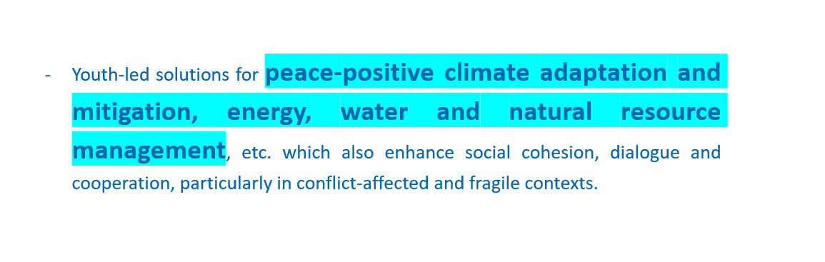

Slide 11
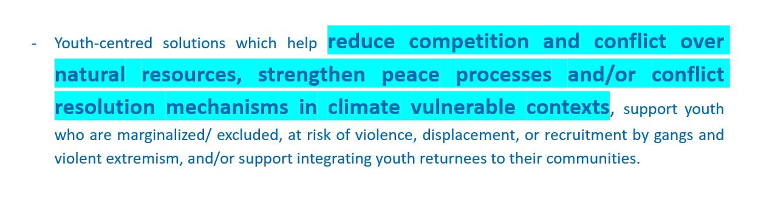

Slide 12
Strengthened decision-making around natural resource management
Social cohesion, dialogue and cooperation
Engages youth and communities affected by conflict and displacement
Peacebuilding approaches
Conflict-resolution mechanisms
Youth Innovators
Youth Leaders
Youth Entrepreneurs
Youth Peacebuilders
Climate action
Climate change
adaptation
Climate resilient food, energy, water solutions
+
+

Slide 13
Climate Peace and Security aspects where
innovation and action are most needed
  Climate-induced resource-based conflicts
  Digital community climate security risks awareness
  Gender Roles in Climate, Peace and Security
  Youth as Agents for Environmental Peacebuilding
  Traditional Knowledge Sharing
  Local Sustainable Livelihoods and Economic Opportunities

Slide 14
Impactful youth-led initiative in
addressing Climate Peace and Security
challenges
  Local Ownership
  Local Knowledge Integration
  Innovative and Adaptive Solutions
  Strong Local Networks/partnerships

Slide 15
Practical considerations, common pitfalls or challenges
changemakers should anticipate when designing
CPS solutions
  Local Context relevance/Knowledge
  Stakeholder Engagement
  Scalability and Sustainability
  Data-Driven Decision Making

Slide 16
Solutions that are inclusive and
responsive to local needs
  Adopt a participatory approach
  Gender Inclusions
  Local cultural context and integrating traditional knowledge
  Embrace technology and innovation
  Local ownership and long-term sustainability

Slide 17
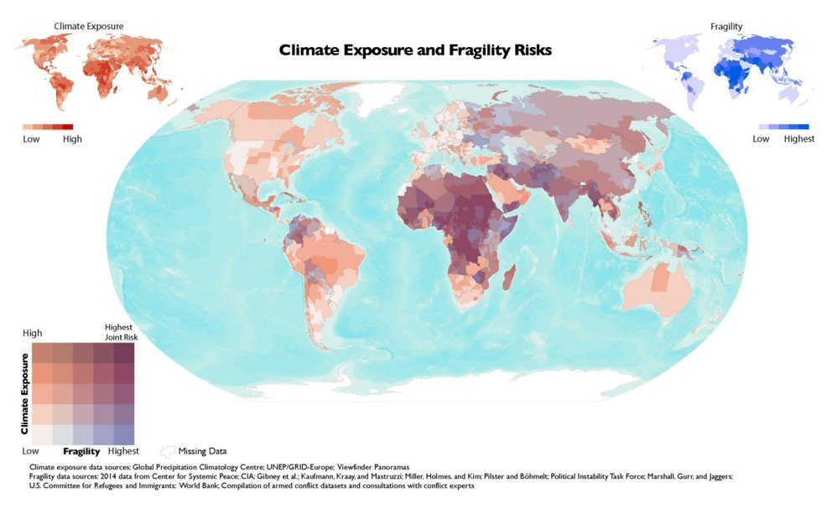
Why engaging with youth to address climate security risks

Slide 18
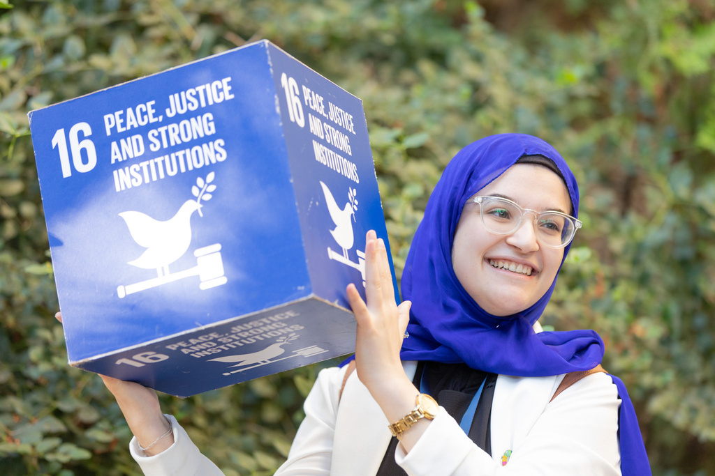
Why youth matters
  There is a demographic dividend to seize: At 1.9 billion, there are more young people than at any other time in history. Nine out of 10 young people in the world live in programme countries. In most of them, 60-70% of the population is below 30. One in four young people is affected by violence or armed conflict.
  It is an urgent democratic issue: Young women and men face a wide array of development challenges and are frequently involving negative assumptions about age, experience and capabilities. Young people are still victims of discrimination, repression and threats.
  It is high time we recognize and support young people as transformative forces for sustainable development: Many young people are responding to today’s challenges contributing fresh ideas and innovative solutions and driving development and peace for themselves, their communities and their societies, and their contribution and potential should be valued and supported.

Slide 19
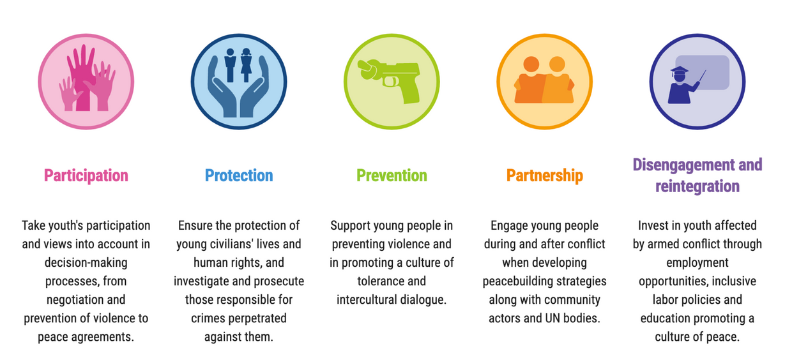
Intersection with the YPS agenda
  The YPS agenda recognizes the important and positive contributions of youth in conflict prevention and resolution. It moves beyond seeing youth as victims or perpetrators of violence, highlighting their potential as peacebuilders and agents of change.

Slide 20
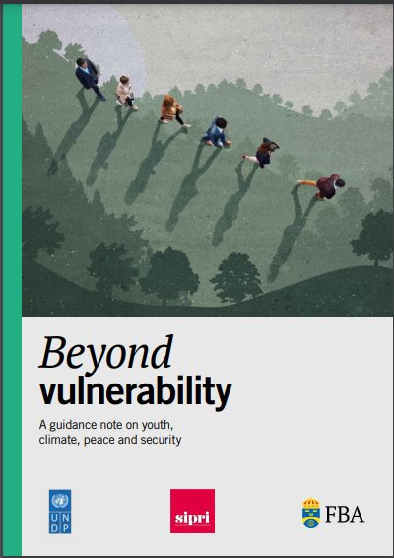
Key findings on Climate, Youth, Peace and Security
Beyond vulnerability: A guidance note on Youth, Climate, Peace and Security

Slide 21
How do young people respond to climate-related security risks?
Increasing and disseminating knowledge on the interlinkages of climate change & armed conflict
Advocating for policy change on climate, peace and security
Working for peace through sustainable livelihoods and natural resource management

Slide 22
Youth at the forefront – Climate, Peace and Security
  Increasing and disseminating knowledge on the interlinkages of climate change and armed conflict​
  Youth-led climate security research in Sudan​
  Reports by young people on the link between climate and disarmament at global level​
  Young climate security communicators in Nigeria​
  Youth-led ToTs on climate and security in Dominica​

Slide 23
Youth at the forefront – Climate, Peace and Security
  Advocating for policy change on climate, peace and security​
  Youth climate advisors to the UN Secretary-General​
  Young people increasing government cooperation on climate & security in Somalia ​
  Youth advocacy on the impact of climate change on human security in Brazil

Slide 24
Youth at the forefront – Climate, Peace and Security
  Working for peace through sustainable livelihoods and natural resource management​
  Young people working together for sustainable water resource management and peace in Somalia and Paraguay/Brazil​
  Youth developing climate-smart agriculture with farmers to improve food security in flood-affected areas of Pakistan​
  Young people leading coral restoration in Tuvalu and Vanuatu to maintain livelihoods​
  Young people planting trees in Somalia across clan boundaries​
  Young people producing bio charcoal to protect the environment and strengthen livelihoods for the vulnerable in DRC​

Slide 25
Some conclusions (guidance note)
  It is about the intentionality in young people’s CPS initiatives​
  Young people have the capacity for integrated analysis on climate, peace and security​.
  The climate security field can reap significant benefits from the YPS agenda to avoid harmful and inaccurate narratives and employ an evidence-based approach to youth.
  Local youth-led initiatives should be supported and resourced, not crowded out​
  Flexible and risk-tolerant climate, peace and security funding for youth-led organisations is needed, including in conflict areas.

Slide 26
Q&A

